Slide 1
Opening
Answer the following ?’s:
1) Define government in your notebook (in your words).
2) Why do people need government?
  People have a need for system of exercising authority & societal control
  Creates organization & eliminates chaos

Slide 2
Governments
2000 B.C. Small towns existed in Greece
  The people designed governments or a system of controlling society
Utilized Monarchy, Aristocracy, Oligarchy, & Democracy
Monarchy: Single person ruler (King or Queen)
Aristocracy: Ruled by small noble families who owned most of the land
Oligarchy: Government of a few powerful people
  Mutated from Aristocracy
Democracy: (demos kratos) People Power or Rule of the people
  Limited: People elect representatives to conduct business of government
  Direct: People participate in government directly by making & voting on laws

Slide 3
Rise of Democratic Ideas (600 B.C.)
Greece builds an aristocracy
  Government ruled by the nobles
  Adult males
Athens began to struggle economically
  Large divide in classes was leading to civil war
Reforms of Solon (So-luhn)
  Limited Democracy (Similar to the United States)
    People elect Council of 400 to make laws
  4 Classes of people were given rights of participation
    Upper 3 could hold public office
    The bottom class could vote like the others
  Classes made of free male voters

Slide 4
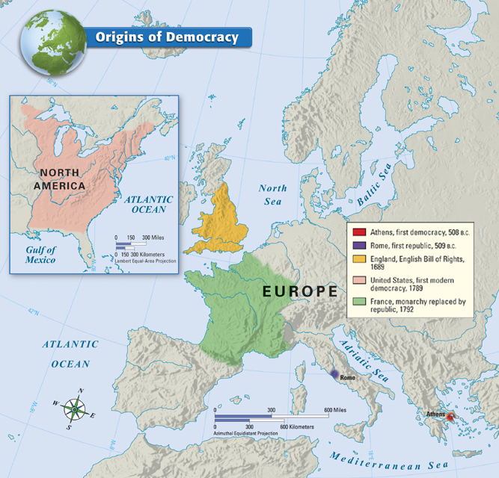

Slide 5
Athens Democracy Expands
Limited Democracy Problems
  Poor citizens could not vote because of poll taxes
  Poor citizens could not sit on juries
    Jurors were not paid
    Could not miss work
Pericles reforms the government (490 B.C.)
  Increased number of paid officials & paid jurors
  New leader forms a Direct Democracy
  Citizens have to vote to create good laws

Slide 6
Opening
Define republic government in your notebook (in your words).

Slide 7
Development of a Republic
Rome was rule by a King (600 B.C.)
509 B.C. Aristocrats overthrew the Roman King
  Set up a new government…Called a republic
Republic
  Form of government in which the power rests with citizens to elect leaders to make decisions
  AKA?

Slide 8
Struggle for Power in Rome
Patricians (Aristocrats) held most of the power
  Inherited
Plebeians wanted power
  Farmers, Artisans, Merchants
  Had voting rights but couldn’t hold public office
Plebeians fought and received power from the Patricians
  12 Tables: Written laws that guaranteed all free citizens protection

Slide 9
Rome’s Republic
Government with separate branches
Legislative Branch
  Senate
    Made up of Patricians (Aristocrats)
    Controlled foreign & financial policies
  2 Assemblies
    More democratic
    Included multiple classes of citizens

Slide 10
Roman Law
All citizens had the right to equal treatment under the law
Person was innocent until proven guilty
Burden of proof rested with the accuser rather than the accused
Unreasonable laws can be set aside
All laws were written to ensure they would last

Slide 11
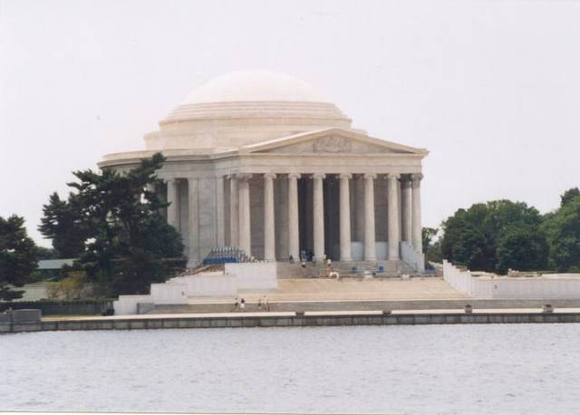
America’s Political Heritage
Our Government…Our Future
What Monument do You See?

Slide 12
A Voice In Government
Colonies chose (elected) representatives to the legislature
  A group of people chosen to make the laws
  Self government
Early Legislature
  Started in Virginia 1619
  Representatives call burgesses
    Virginia House of Burgesses
  Governor had final say over the law

Slide 13
Citizenship in the Colonies
What is citizenship?
Early Citizens
  ONLY large landowners had voting rights
  White males
    Belief that they were the only people affected by the laws
    Only people who are educated and understand politics
All people wanted voting rights but were denied

Slide 14
Good Citizenship
Common Good
Work towards a better community
  Serve on juries
  Members of a militia
Support Education
  Set up public school system
  Read & understand the bible

Slide 15
Roots of Freedom
Greater Religious Freedom
All citizens of England had to pay taxes to support the Anglican Church
People left England (Pilgrims) for religious freedom

Slide 16
Freedom of the Press
Press is a source of information
  Did not exist in England
Press could not criticize government
Argument Started 1735
  John Peter Zenger
  New York Weekly Journal
    Criticized New York governor for accepting bribes
  Zenger was found not guilty

Slide 17
Signs of Discontent
Signs of tyranny
  Abuse of power
Press accused governors for abusing power
  Arbitrary power
People were worried they would lose all rights

Slide 18
Building a New Government
Looking to the Past

Slide 19
Ancient Greece & Rome
Athens (Greece)
  Utilized a Direct Democracy
    People cast individual votes for each issue
Rome
  Utilized a Republic government
    Representatives elected to cast votes for issues
    Representatives represent our interests

Slide 20
Rights of People
Natural Rights
  Rights people are born with that government cannot take away
Life, Liberty, Property
Developed by John Locke
  Government exist for the people…not the people for the government
Governments who abuse rights should not be obeyed

Slide 21
Powers of the Government
Government branches oversee the government
(Montesquieu)
United States Constitution
Legislative Branch
Congress
Make Laws
Override Veto
Executive Branch
President
Enforce Laws
Veto Power
Judicial Branch
Supreme Court
Review Laws
Overrule Laws

Slide 22
Revolution Causes
French & Indian War (1763)
  French & Indians vs. Britain & Colonies
  War caused tighter trade laws
Mercantilist economics
  French & Indian War caused huge debt for Britain
  American colonies benefited → Expected to pay war costs
    Parliament passes the Stamp Act (1765)
    Colonists believed act was against natural rights & was taxation without representation
    Boycott led to repeal of Stamp act in 1766

Slide 23
Causes (Cont)
Boston Tea Party (1773)
  Tax on imported tea
  John Adams led raid against 3 British Ships
  Dumped 342 chests of tea into Boston Harbor
  British troops closed the ports and occupied the city

Slide 24
Declaration of Independence
Declaring Independence

Slide 25
Declaring Independence
September 1774
  Representatives gather from every colony except Georgia
  First Continental Congress
  Held in Philadelphia
  Formally protested King George III
    Complaints Ignored
  Second Continental Congress held with all colonies

Slide 26
Declaring Independence
April 19, 1775
  British soldiers & American militiamen trade gun fire in Lexington, MA
  Fight spread to Concord
    Second Continental Congress voted to raise an army
    George Washington voted as Leader
  American Revolution had begun

Slide 27
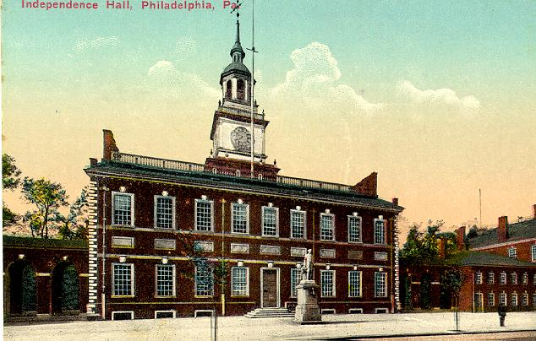

Slide 28
Declaring Independence
Second Continental Congress Issued Declaration of Independence (July 1776)
Written by Thomas Jefferson
  Based on the ideas of John Locke
  Citizens had natural rights
  Listed abuses by the king

Slide 29
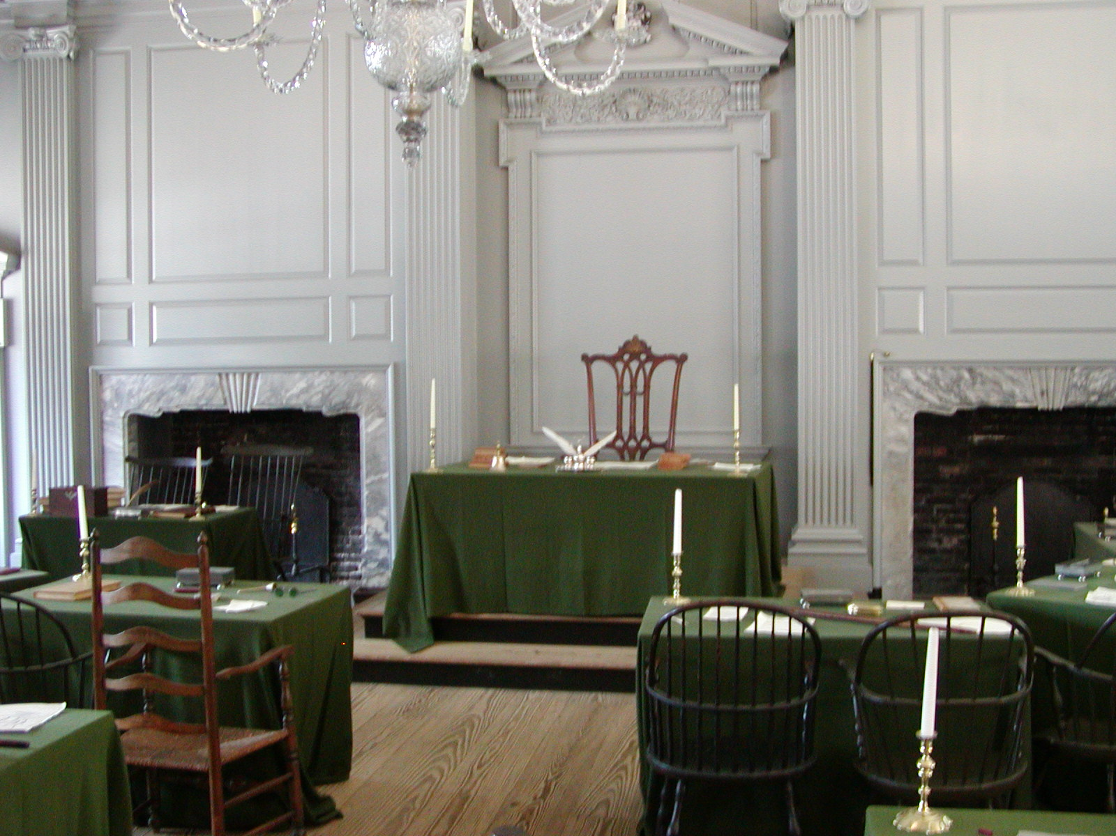
Declaring Independence
Reason for Success
  Motivated fighters
  Overconfident British made mistakes
  Americans were at home
  France entered war in 1778
    Under King Louis XVI
9,500 Americans & 7,800 French trapped Britain near Yorktown, VA
1781 Cornwallis surrendered

Slide 30
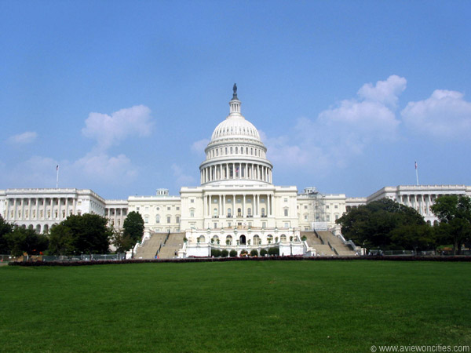
The Constitutional Convention

Slide 31
The Convention
12 states met to discuss how to make a stronger central government
It soon became clear that they could not revise the Articles of Confederation and chose to write a new document
This meant what they were doing could be considered illegal.

Slide 32
Key Decisions
Each state would have one vote no matter how many delegates they had at the convention
They agreed to go by simple majority (7)
Kept their work secret because of fear and to eliminate outside pressure.
Because of the secrecy we have no written records of what occurred at the meetings

Slide 33
The Virginia Plan
Powers would be divided among three branches
In the Virginia plan there would be a two house government
In each house representation was based on population
There would also be an executive and Court System

Slide 34
Virginia Plan
The powers of all three branches would be greater than the government of the articles
This plan was favored by states with large populations
Small states feared they would have no power

Slide 35
The New Jersey Plan
Similar to the Articles of Confederation
One house legislature
Each state had an equal number of votes
No court system was provided for
Large states did not like this because they thought they deserved more power

Slide 36
Characteristic
Virginia Plan
New Jersey Plan
Legislature
Two chambers
One chamber
Legislative power
Derived from the people
Derived from the states
Executive
Unspecified size
More than one person
Decision rule
Majority
Extraordinary majority
State laws
Legislature can override
National law is supreme
Executive removal
By Congress
By a majority of the states
Courts
National judiciary
No provision for national judiciary
Ratification
By the people
By the states

Slide 37
Page 95 – Questions 1-6
Due at the end of class

Slide 38
Constitutional Compromises
Delegates argued for weeks about the structure of government
They also argued key topics which faced the country at the time
Slavery
Taxes
Electing a leader

Slide 39
Connecticut Compromise
Three Branches of government
Two house legislature
Representation in one house was based on population (House of Reps)
In the other house there was equal representation for all states (senate)

Slide 40
3/5 Compromise
Second time in our short history we let African Americans down
Said slaves would be counted as 3/5 of a person for taxes and representation
Who is this compromise between?

Slide 41


Interstate Trade (commerce)
This is what got Michael Vick and Martha Stewart

Slide 42
The Slave Trade Compromise
The third time we let African Americans down
Many states did not want slavery and felt congress should have the power to control it
Many states saw slavery as essential to their economy and didn’t want congress to outlaw it
Delegates feared the issue would tear the meetings apart
Slave states agree to let congress regulate trade as long as they don’t talk about the slave trade for 20 years

Slide 43
The Electoral College
Many thought only the wealthy and educated (like congress) should pick the president
Many thought everyone should get to choose.
They decide the state government (chosen by the people) should get to choose electors
Now voters choose electors directly

Slide 44
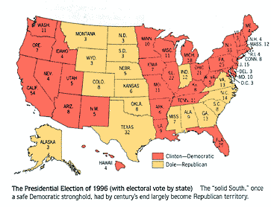

Slide 45
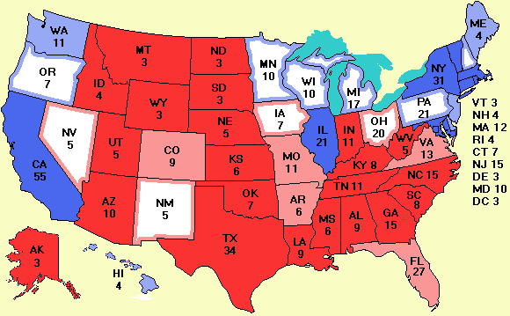

Slide 46
Federal System
Power divided among the national and state governments
Constitution gives specific powers to national Government.
Coin money
Declare war
Etc
All other powers are assumed to belong to the
States.

Slide 47
Federalism in the United States

Slide 48
Federal System
Power is divided between the State and National Government
Federalist felt this would keep citizens safe from abuses by the government
Thought it would protect both citizens and states rights

Slide 49
Layer Cake
The sharing of powers would work because they are supposed to be separate like the layers of the cake
National on top, State in the middle, local on the bottom
In theory these levels have distinct powers

Slide 50
Powers given to the levels
National- powers clearly stated in the constitution in articles I,II and III
Supremacy Clause- When national is at conflict with any other level the national wins
State “assumed” to have the powers not given to the national in the constitution
(10th amendment)
However many court cases and amendments since then have increased the power of the nation over the states

Slide 51
Marble Cake
Today most look at federalism as a marble cake
The layers are all swirled together
This is because many powers are concurrent- shared between state and nation (like taxes)
Since powers are shared so are the responsibilities

Slide 52
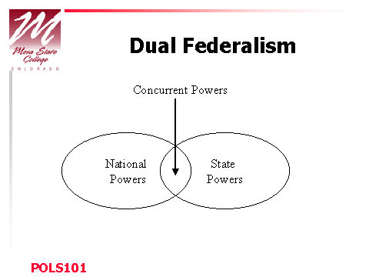

Slide 53
Federalists v. Anti-Federalists
The Debate over Ratification
What did Federalist think?
What did anti-federalists want?

