Slide 1
What was state-side America like
during World War II?
What similarities were there with WW I?
What changes were taking place?

Slide 2
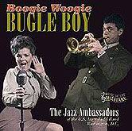
America
on the Home Front
During World War II

Slide 3
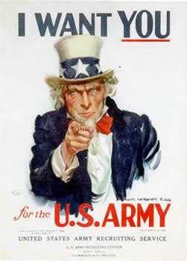
Your Number Was Called!

Slide 4
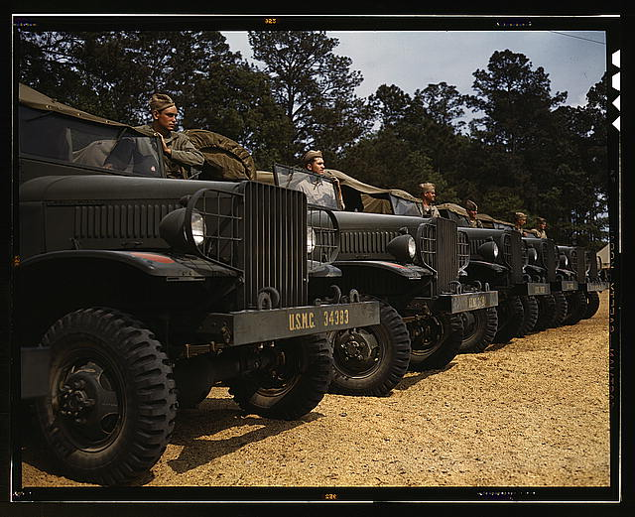
Marine Corps Motor Pool

Slide 5
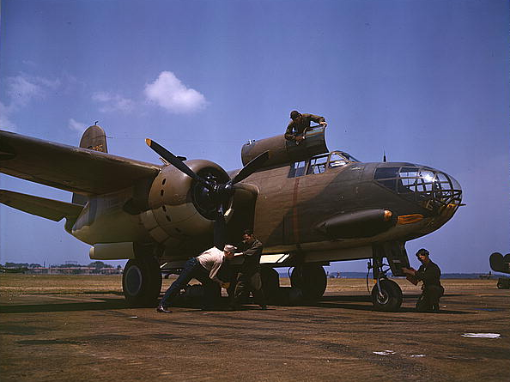
Servicing U. S. Bombers

Slide 6
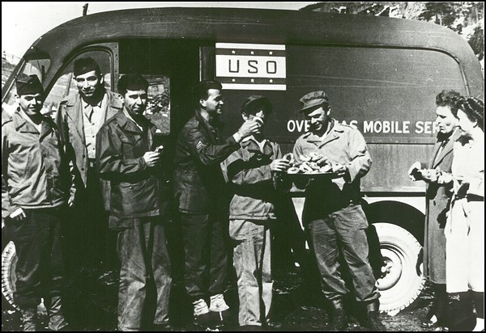
USO Canteen

Slide 7
The Andrew Sisters Singing “Boogie Woogie Bugle Boy”

Slide 8
Betty Grable: Allied Pinup Girl
She Reminded Men What They Were Fighting For

Slide 9
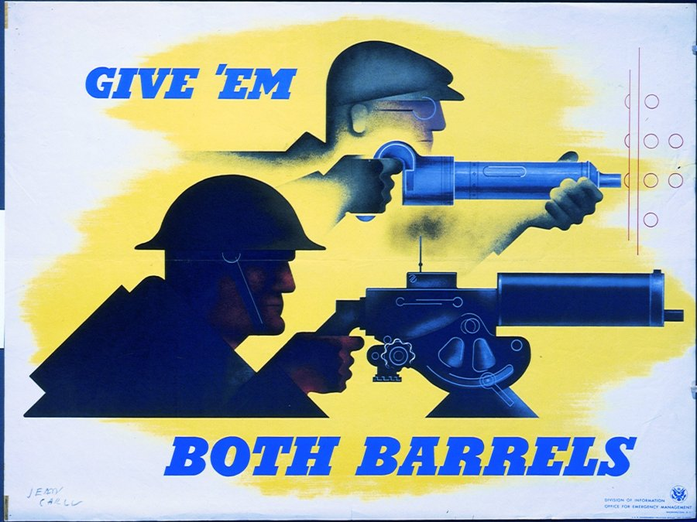
Fighting the Enemy on the Battlefield & on the Home Front

Slide 10
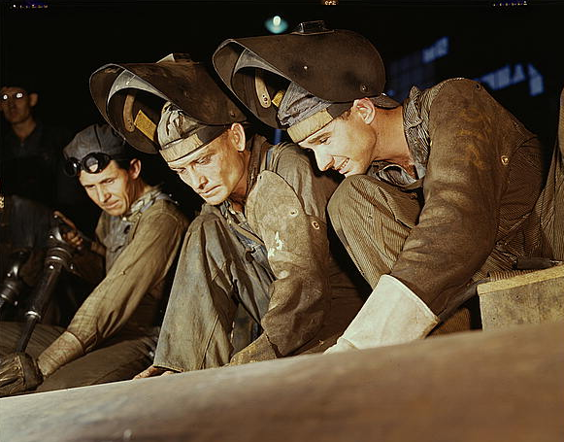
Working on the Assembly Line

Slide 11
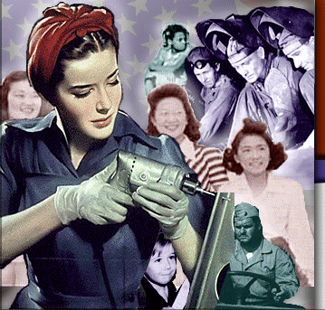
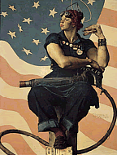
“Rosie, the Riveter”

Slide 12
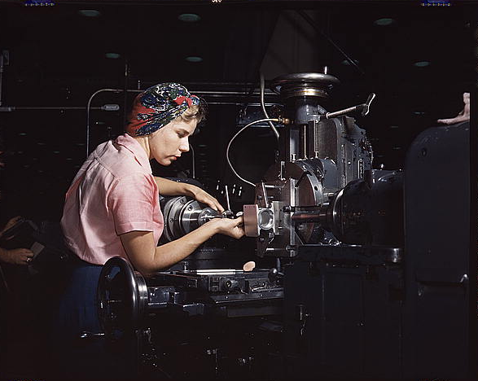
Fix that Engine!

Slide 13
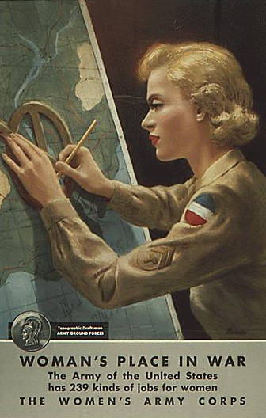
Join the Women’s Army Corps

Slide 14
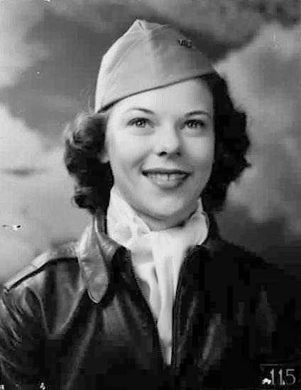
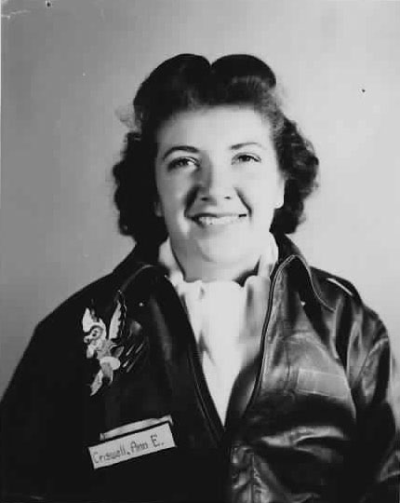
Women’s Army Air Corps Pilots

Slide 15
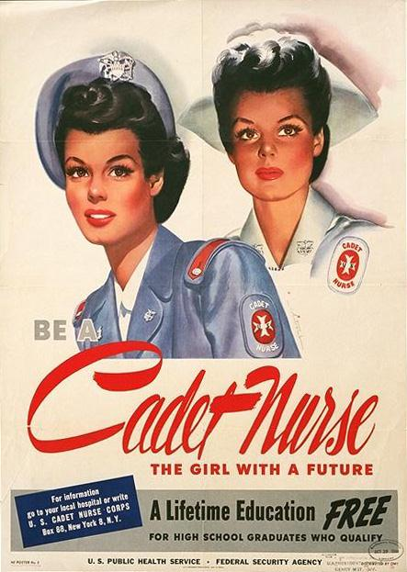
We Need Nurses Badly

Slide 16
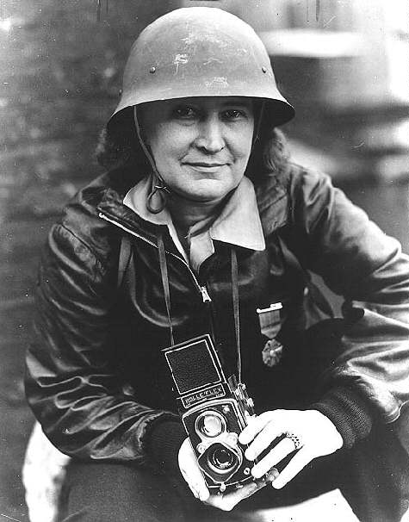
Female War Photographer

Slide 17
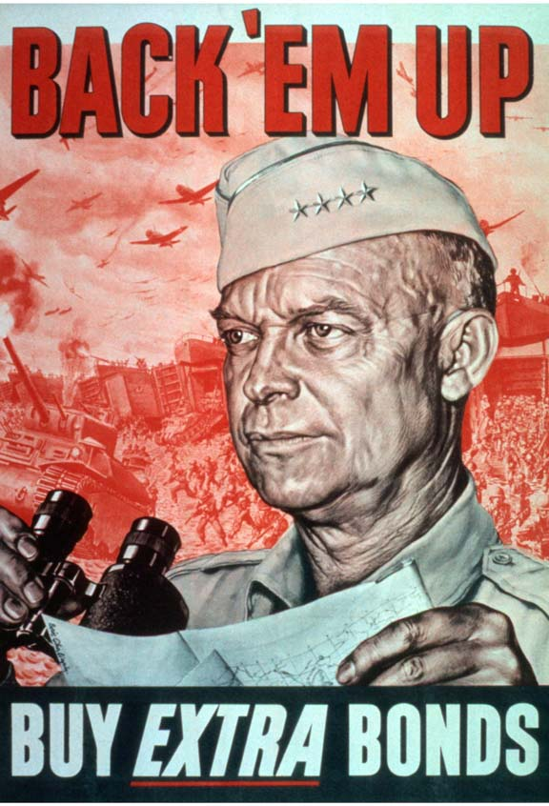
Do Your Bit!

Slide 18
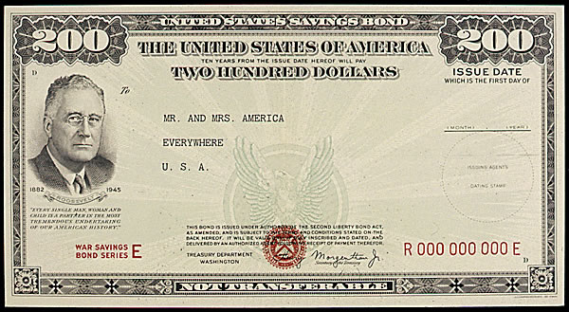
Buy, Buy, Buy, Buy a Bond: It Will Lead to VICTORY!

Slide 19
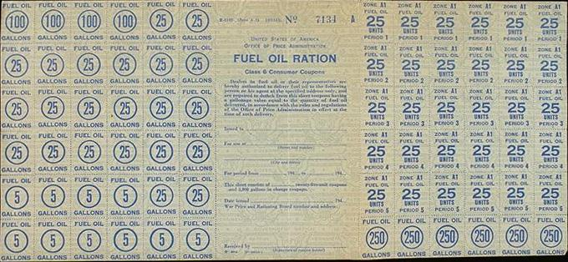
Get Your Ration Cards

Slide 20
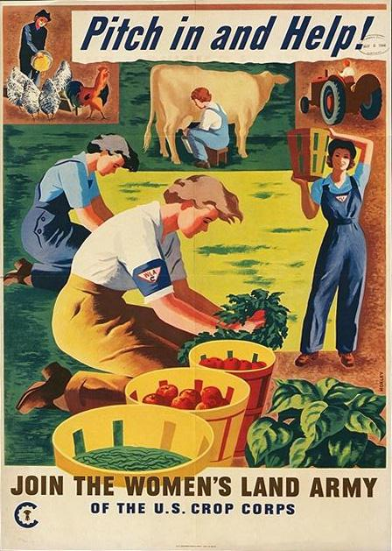
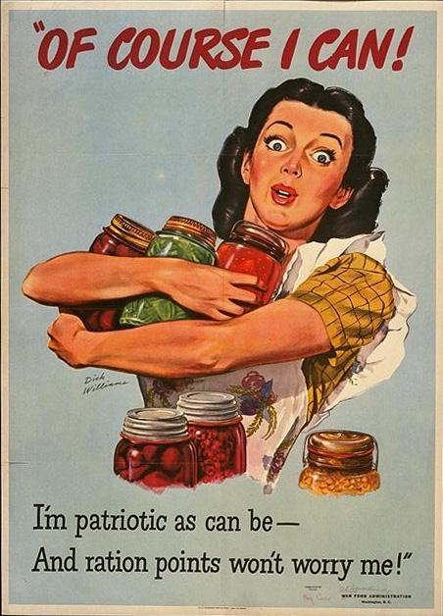
S..t..r..e..t..c..h That Food!

Slide 21
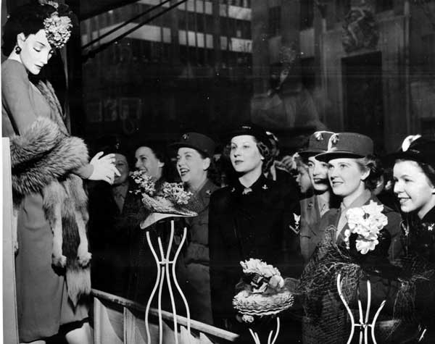
No New Dresses for a While

Slide 22
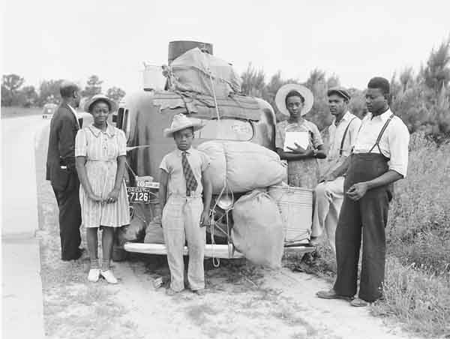
On the Road Looking for Work

Slide 23
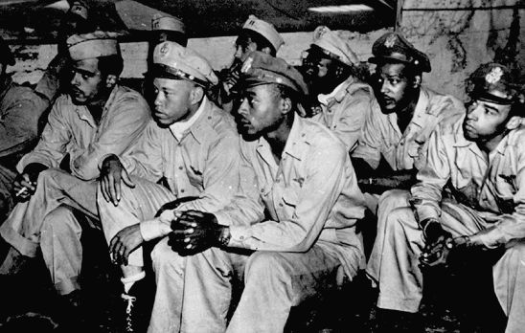
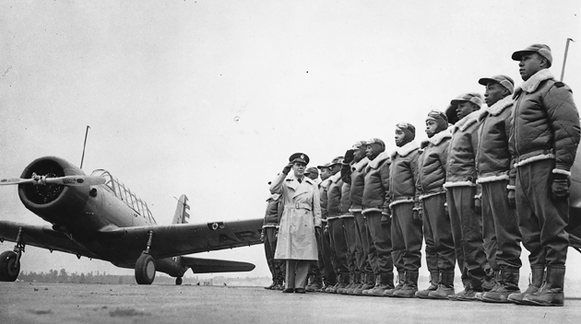
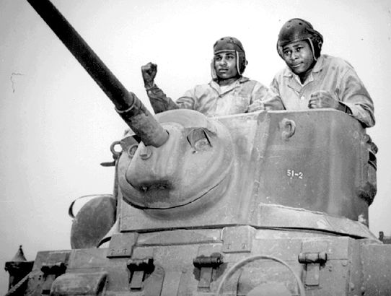
Segregated Units

Slide 24
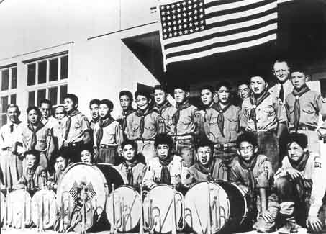
Japanese-American Boy Scout Troop in an Internment Camp

Slide 25
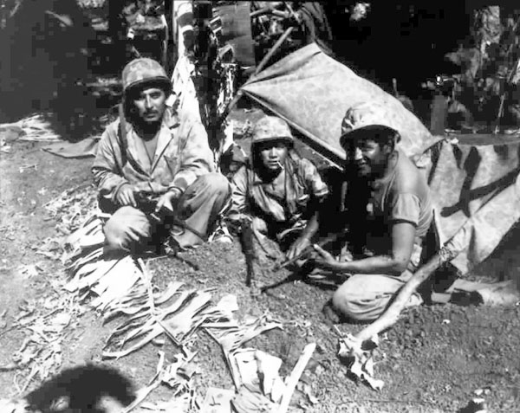
Navaho “Code Talkers”

Slide 26
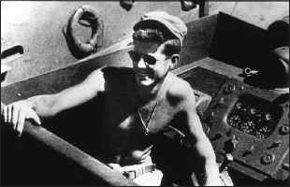
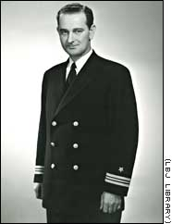
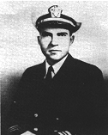
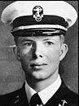
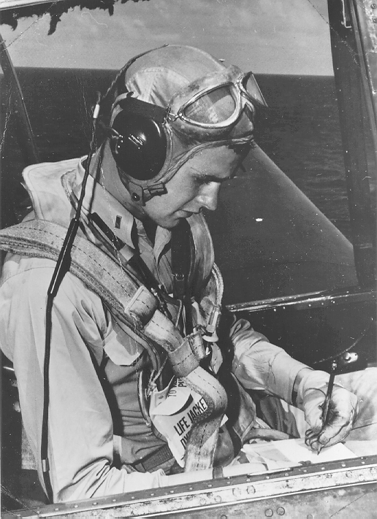
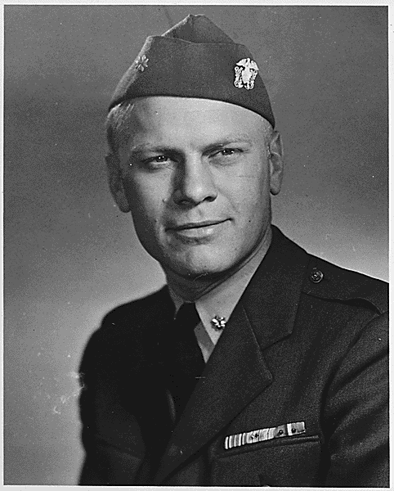
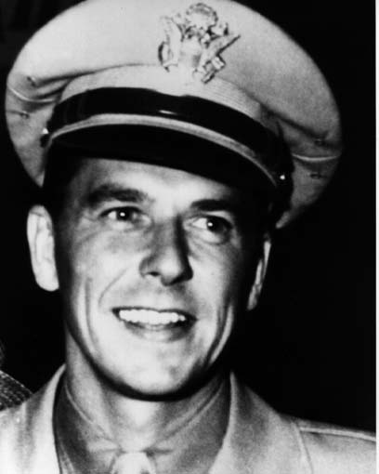
7 Future American Presidents Views of the World Were Formed by Their Service in World War II

Slide 27
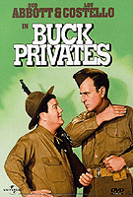
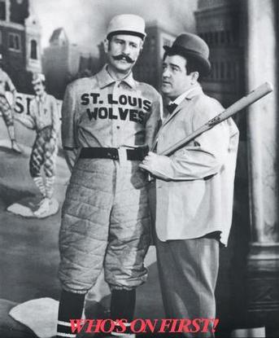
Abbott & Costello: “Buck Privates”

Slide 28
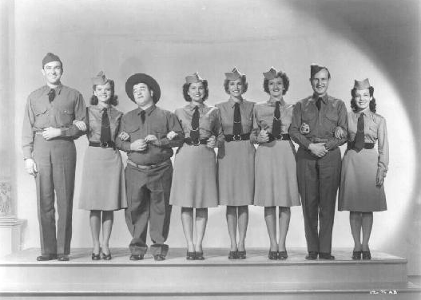
Hollywood Pitches In

Slide 29
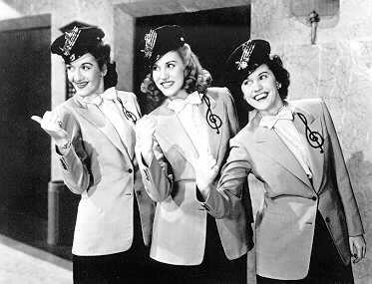
He’s the Boogie Woogie Bugle Boy of Company B

Slide 30
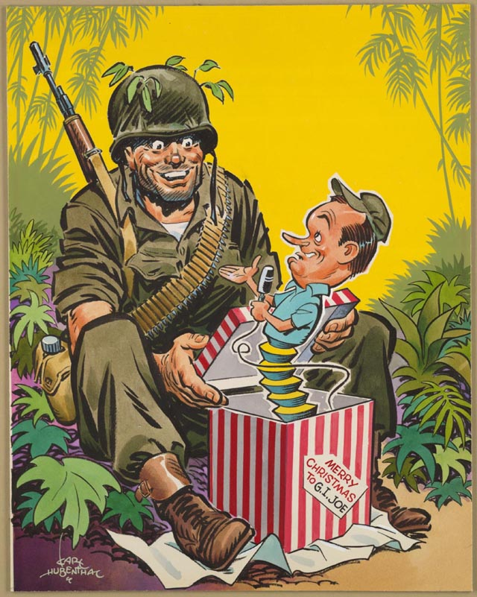
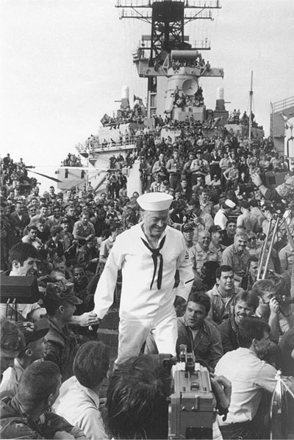
Bob Hope in the South Pacific

Slide 31
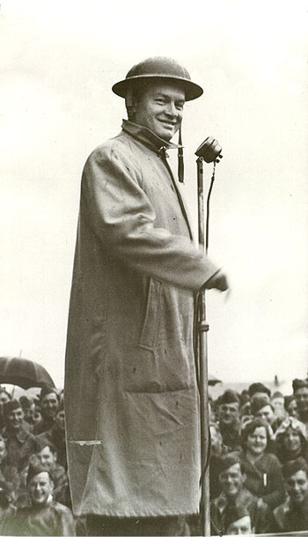
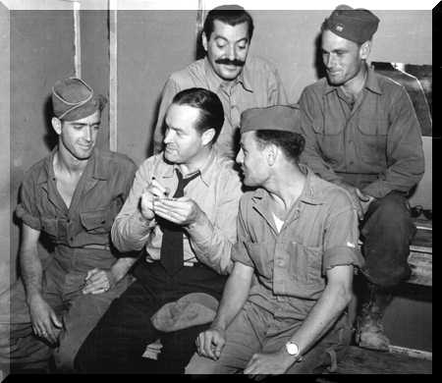
Thanks, for the Memories!

Slide 32
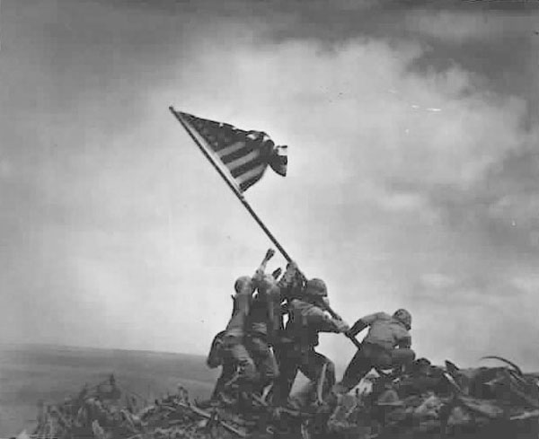
Mt. Suribachi, Iwo Jima

Slide 33
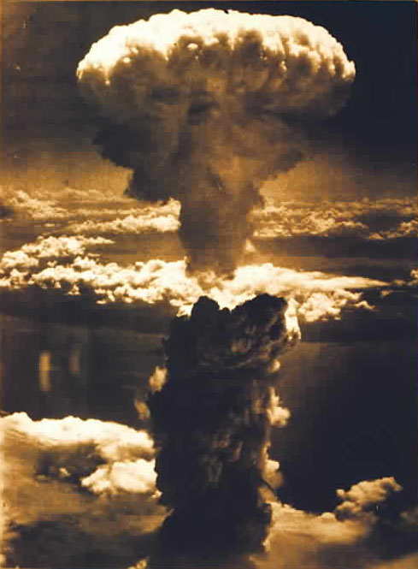
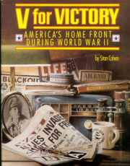
The Beginning of the Nuclear Age

Slide 34
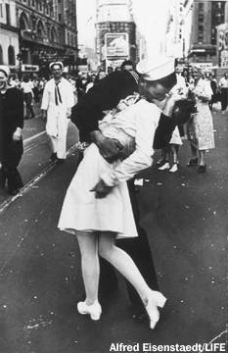
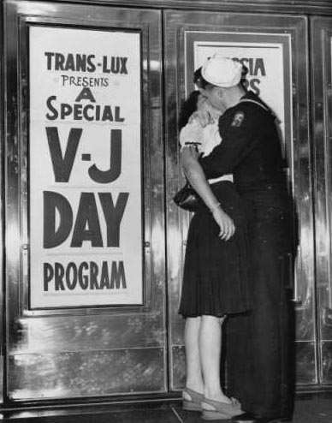
It’s Finally Over!!!!!

Slide 35
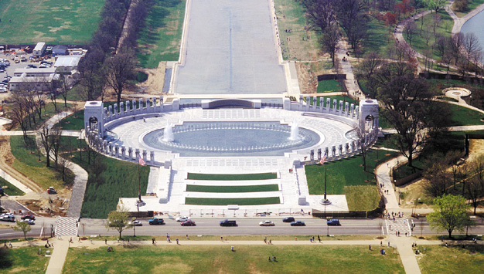
WW II Memorial in Washington, DC
Dedicated on April 29, 2004

