Slide 1
Chapter 6 Notes
Sectional division intensifies

Slide 2
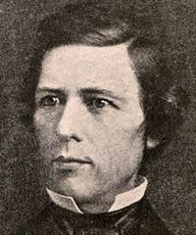
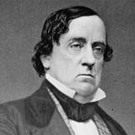
Wilmot Proviso vs Popular Sovereignty
Wilmot – Dem – PA
Lewis Cass – Dem - MI

Slide 3
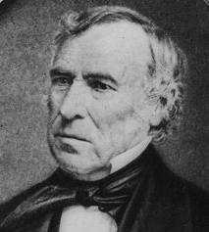
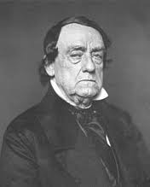
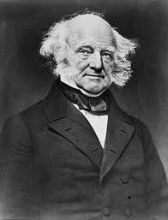
Free Soil Spoils the Party
Whig Candidate – Zachary Taylor
Democrats – Lewis Cass
Free Soil – Martin Van Buren

Slide 4
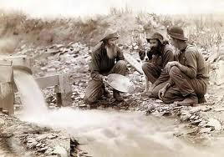
Forty Niners…..
1849 – Gold Rush is on
15 Slave States???
15 Free States???

Slide 5
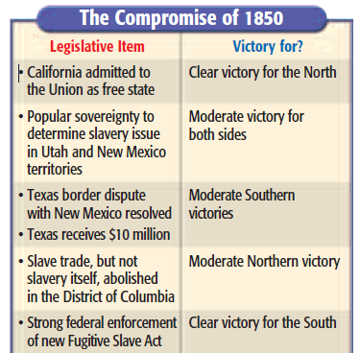
Henry Clay – Compromising again
When did we see Clay’s first big compromise?

Slide 6
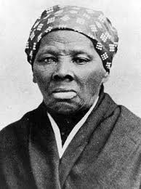
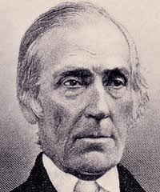
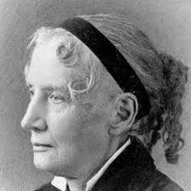
Underground Railroad
Harriet Tubman
Levi Coffin
Uncle Toms Cabin

Slide 7
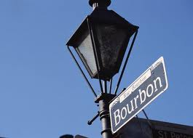
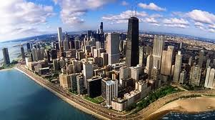
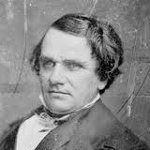
Transcontinental Railroad
Where should it start?
Gadsden Purchase
Stephen Douglas – Illinois Senator…

Slide 8
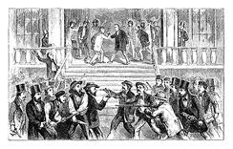
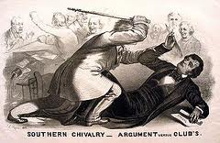
Turmoil continues
Bleeding Kansas
Charles Sumner

Slide 9
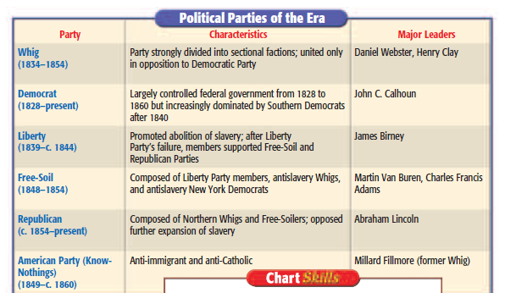
Party, Party, Party

Slide 10
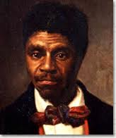
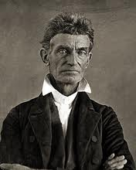
More turmoil
Dred Scott
John Brown

Slide 11
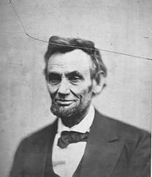
Abraham Lincoln
Debates
Election 1860

Slide 12
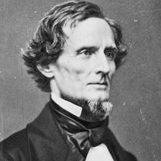
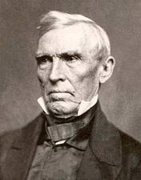
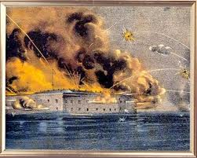
The fall…
Jefferson Davis
Crittenden’s Compromise
Fort Sumter
Hanging on by a thread (D.C.)

Slide 13
Expansion & Sectionalism- President John Tyler (1841-1845), James K. Polk (1845-1849), Zachary Taylor (1849-1850)
Manifest Destiny- idea that God had given the continent to whites to conquer; many people used this thinking to justify taking land from Native Americans and others.
Pre-emption Act 1830- protected squatters by guaranteeing them the right to claim land before it was surveyed and right to buy up to 160 acres at $1.25/acre;
government encouraged settlers to move west.

Slide 14
More people moving west = better technology
Squatters- people who settled on land they did not own in the west.
Jethro Wood- developed an iron bladed plow to cut the sod of the Great Plains.
John Deere- invented a steel bladed plow; more durable than iron.
Cyrus McCormick- invented a wheat harvester which increased wheat productivity.
John Sutter (California)- Sutter’s Fort (1st stopping point for Americans in California).
Mountain Men (Kit Carson, John Bridger) established east-west trails (Oregon Trail).
Empresarios in Texas (Stephen Austin)

Slide 15
War with mexico
Mexican/American War : Alamo/ Texas independence (Alamo)/ Annexation of Texas
Polk 1844 election ; annex Texas, buy California, “54,40 or Fight”
1848 Treaty of Guadalupe Hidalgo- ends Mexican-American War; US gains 500,000 sq. miles
Wilmot Proviso- Proposed that in land won from Mexico- no slavery would exist: did not pass but showed tensions over slavery.
Popular Sovereignty- idea proposed that people who settle the territories won from Mexico will determine whether slavery would exist or not.
Free Soil Party- party that proposed that territories be kept as free soil to preserve

Slide 16
1849 Gold Rush-California (California enters the Union)
1850 Compromise- (Henry Clay): California in as Free State; rest of Mexican cession no restrictions on slavery, new fugitive slave act, Slave trade outlawed in DC but not slavery.
1850 Fugitive Slave Act- required Northerners to help capture runaway slaves or face fines or jail; angered Northerners against the South & slavery more.
Uncle Tom’s Cabin- book by Harriet Beecher Stowe; caused many Northerners to side with abolitionists- to fight to end slavery.
1849 “Civil Disobedience” (Henry David Thoreau) – disobey unjust laws on moral groundsinfluenced
Martin Luther King and Ghandi.
The Underground Railroad- abolitionists set up safe houses and helped blacks escape from slavery to freedom in the north (Harriet Tubman-one of the most famous “conductors”).

Slide 17
President Millard Fillmore (1850-1853) –President Franklin Pierce (1853-1857)
Gadsden Purchase (1853)- US paid $10 million for 30,000 acres (S. Arizona, New Mexico)
* KANSAS/Nebraska Act(1854)-Stephen Douglas; divided the territories west of Missouri and Iowa into two territories (Kansas- slave territory & Nebraska-free territory) broke promise of Missouri Compromise.
Bleeding Kansas- pro-slavery & antislavery settlers moved quickly to Kansas; fighting broke out 1855.
Dred Scot- Scot vs. Sanford (1857)- Supreme Court ruled that African-Americans could not sue in court, Missouri Compromise was unconstitutional (US government cannot stop slavery in the territories).

